Slide 1
Styles and
Greenfield Design
Software Architecture
Lecture 6

Slide 2
Heterogeneous Styles
More complex styles created through composition of simpler styles
REST (from the first lecture)
  Complex history presented later in course
C2
  Implicit invocation + Layering + other constraints
Distributed objects
  OO + client-server network style
  CORBA

Slide 3
C2 Style
An indirect invocation style in which independent components communicate exclusively through message routing connectors. Strict rules on connections between components and connectors induce layering.

Slide 4
C2 Style (cont’d)
Components: Independent, potentially concurrent message generators and/or consumers
Connectors: Message routers that may filter, translate, and broadcast messages of two kinds: notifications and requests.
Data Elements: Messages – data sent as first-class entities over the connectors. Notification messages announce changes of state. Request messages request performance of an action.
Topology: Layers of components and connectors, with a defined “top” and “bottom”, wherein notifications flow downwards and requests upwards.

Slide 5
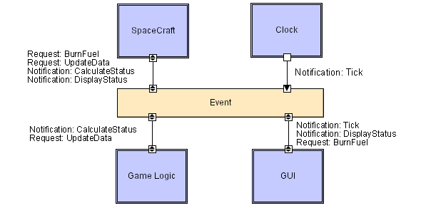
C2 LL
Software Architecture: Foundations, Theory, and Practice; Richard N. Taylor, Nenad Medvidovic, and Eric M. Dashofy; © 2008 John Wiley & Sons, Inc. Reprinted with permission.

Slide 6
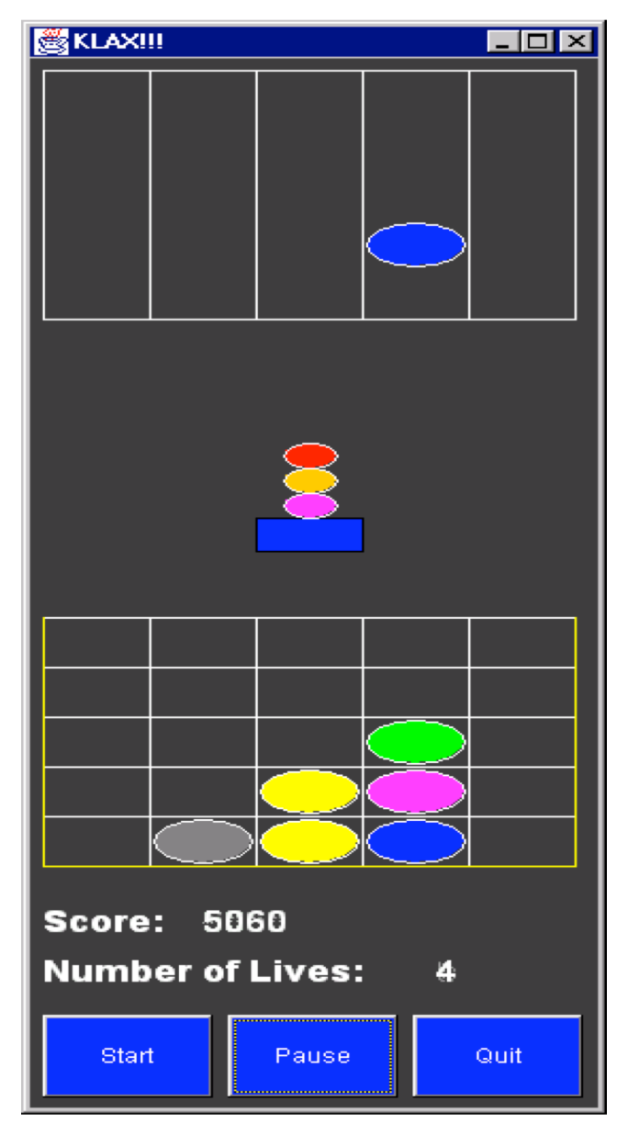
KLAX
Software Architecture: Foundations, Theory, and Practice; Richard N. Taylor, Nenad Medvidovic, and Eric M. Dashofy; © 2008 John Wiley & Sons, Inc. Reprinted with permission.

Slide 7
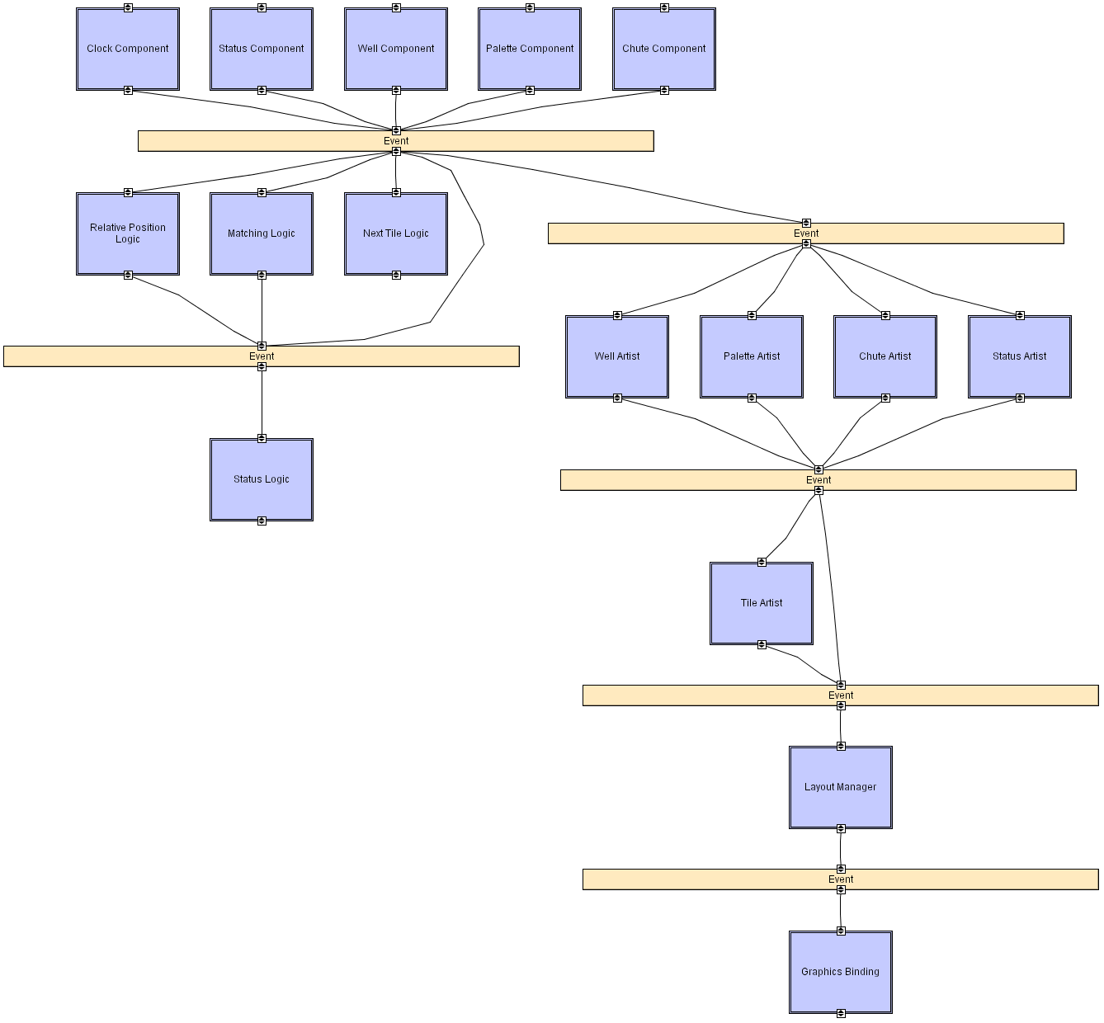
KLAX in
C2
Software Architecture: Foundations, Theory, and Practice; Richard N. Taylor, Nenad Medvidovic, and Eric M. Dashofy; © 2008 John Wiley & Sons, Inc. Reprinted with permission.

Slide 8
Distributed Objects: CORBA
“Objects” (coarse- or fine-grained) run on heterogeneous hosts, written in heterogeneous languages. Objects provide services through well-defined interfaces. Objects invoke methods across host, process, and language boundaries via remote procedure calls (RPCs).
Components: Objects (software components exposing services through well-defined provided interfaces)
Connector: (Remote) Method invocation
Data Elements: Arguments to methods, return values, and exceptions
Topology: General graph of objects from callers to callees.
Additional constraints imposed: Data passed in remote procedure calls must be serializable. Callers must deal with exceptions that can arise due to network or process faults.
Location, platform, and language “transparency”. CAUTION

Slide 9
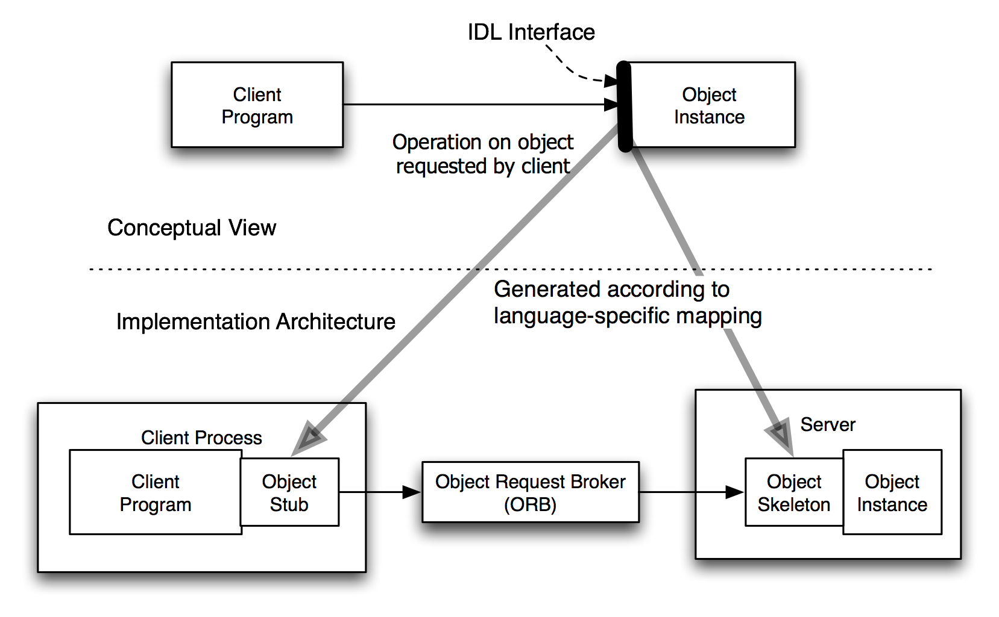
CORBA Concept and Implementation
Software Architecture: Foundations, Theory, and Practice; Richard N. Taylor, Nenad Medvidovic, and Eric M. Dashofy; © 2008 John Wiley & Sons, Inc. Reprinted with permission.

Slide 10
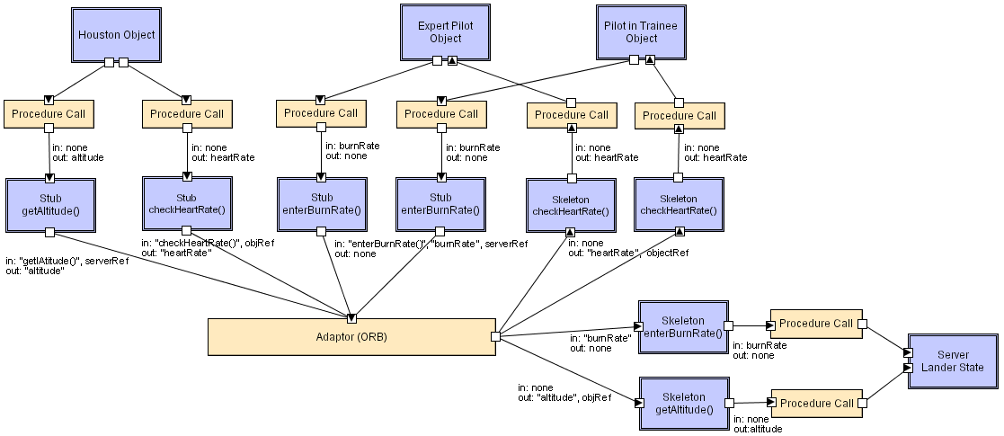
CORBA LL
Software Architecture: Foundations, Theory, and Practice; Richard N. Taylor, Nenad Medvidovic, and Eric M. Dashofy; © 2008 John Wiley & Sons, Inc. Reprinted with permission.

Slide 11
Observations
Different styles result in
  Different architectures
  Architectures with greatly differing properties
A style does not fully determine resulting architecture
  A single style can result in different architectures
  Considerable room for
    Individual judgment
    Variations among architects
A style defines domain of discourse
  About problem (domain)
  About resulting system

Slide 12
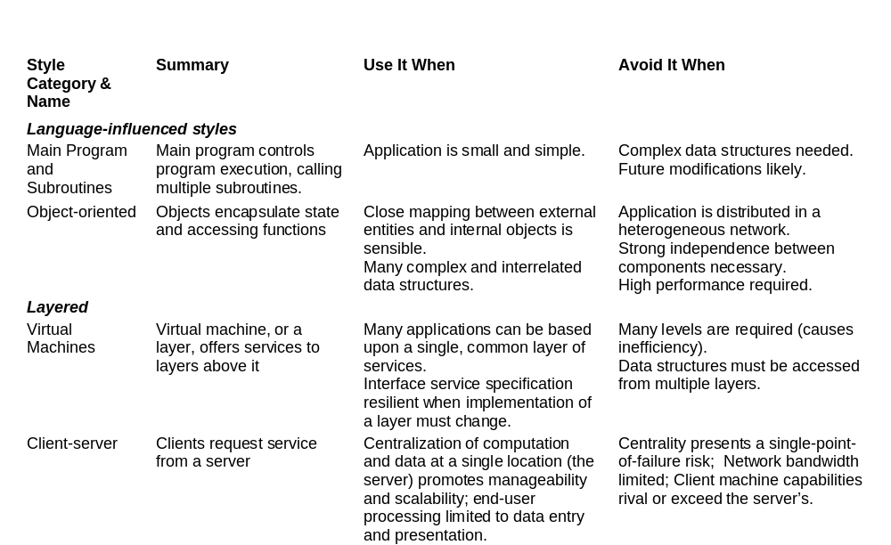
Style Summary (1/4)

Slide 13
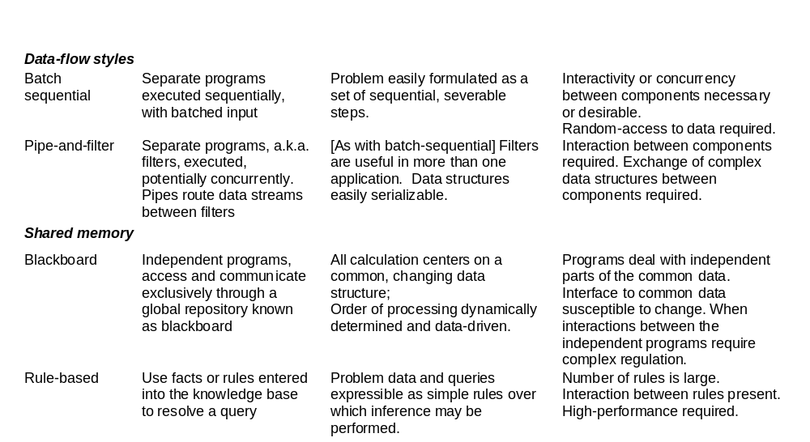
Style Summary, continued (2/4)

Slide 14
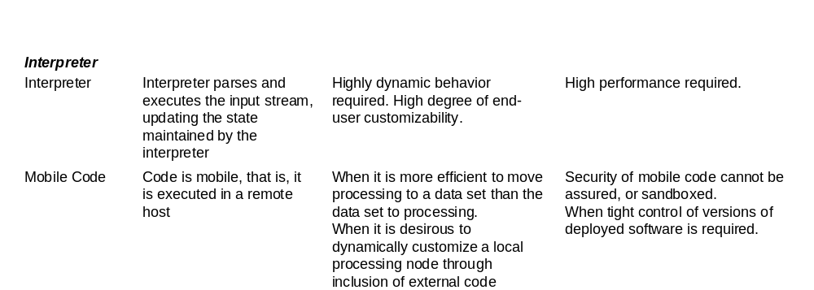
Style Summary, continued (3/4)

Slide 15
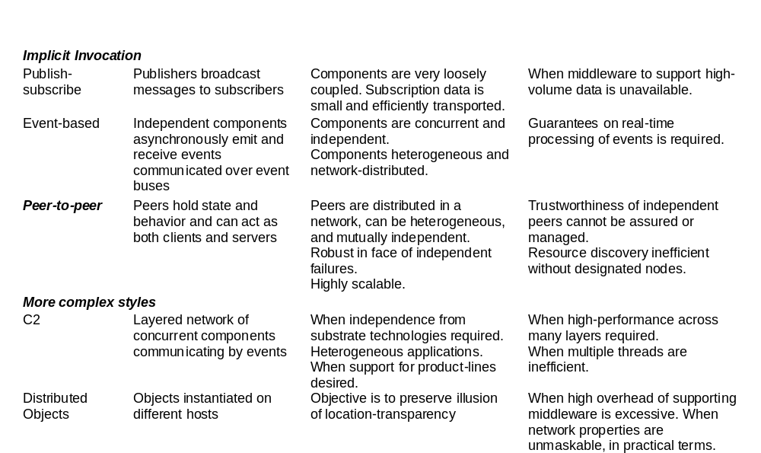
Style Summary, continued (4/4)

Slide 16
Design Recovery
What happens if a system is already implemented but has no recorded architecture?
The task of design recovery is
  examining the existing code base
  determining what the system’s components, connectors, and overall topology are.
A common approach to architectural recovery is clustering of the implementation-level entities into architectural elements.
  Syntactic clustering
  Semantic clustering

Slide 17
Syntactic Clustering
Focuses exclusively on the static relationships among code-level entities
Can be performed without executing the system
Embodies inter-component (a.k.a. coupling) and intra-component (a.k.a. cohesion) connectivity
May ignore or misinterpret many subtle relationships, because dynamic information is missing

Slide 18
Semantic Clustering
Includes all aspects of a system’s domain knowledge and information about the behavioral similarity of its entities.
Requires interpreting the system entities’ meaning, and possibly executing the system on a representative set of inputs.
Difficult to automate
May also be difficult to avail oneself of it

Slide 19
When There’s No Experience to Go On…
The first effort a designer should make in addressing a novel design challenge is to attempt to determine that it is genuinely a novel problem.
Basic Strategy
  Divergence – shake off inadequate prior approaches and discover or admit a variety of new ideas
  Transformation – combination of analysis and selection
  Convergence – selecting and further refining ideas
Repeatedly cycling through the basic steps until a feasible solution emerges.

Slide 20
Analogy Searching
Examine other fields and disciplines unrelated to the target problem for approaches and ideas that are analogous to the problem.
Formulate a solution strategy based upon that analogy.
A common “unrelated domain” that has yielded a variety of solutions is nature, especially the biological sciences.
  E.g., Neural Networks

Slide 21
Brainstorming
Technique of rapidly generating a wide set of ideas and thoughts pertaining to a design problem
  without (initially) devoting effort to assessing the feasibility.
Brainstorming can be done by an individual or, more commonly, by a group.
Problem: A brainstorming session can generate a large number of ideas… all of which might be low-quality.
The chief value of brainstorming is in identifying categories of possible designs, not any specific design solution suggested during a session.
After brainstorm the design process may proceed to the Transformation and Convergence steps.

Slide 22
“Literature” Searching
Examining published information to identify material that can be used to guide or inspire designers
Many historically useful ways of searching “literature” are available
Digital library collections make searching extraordinarily faster and more effective
  IEEE Xplore
  ACM Digital Library
  Google Scholar
The availability of free and open-source software adds special value to this technique.

Slide 23
Morphological Charts
The essential idea:
  identify all the primary functions to be performed by the desired system
  for each function identify a means of performing that function
  attempt to choose one means for each function such that the collection of means performs all the required functions in a compatible manner.
The technique does not demand that the functions be shown to be independent when starting out.
Sub-solutions to a given problem do not need to be compatible with all the sub-solutions to other functions in the beginning.

Slide 24
Removing Mental Blocks
If you can’t solve the problem, change the problem to one you can solve.
  If the new problem is “close enough” to what is needed, then closure is reached.
  If it is not close enough, the solution to the revised problem may suggest new venues for attacking the original.

Slide 25
Controlling the Design Strategy
The potentially chaotic nature of exploring diverse approaches to the problem demands that some care be used in managing the activity
Identify and review critical decisions
Relate the costs of research and design to the penalty for taking wrong decisions
Insulate uncertain decisions
Continually re-evaluate system “requirements” in light of what the design exploration yields

Slide 26
Insights from Requirements
In many cases new architectures can be created based upon experience with and improvement to pre-existing architectures.
Requirements can use a vocabulary of known architectural choices and therefore reflect experience.
The interaction between past design and new requirements means that many critical decisions for a new design can be identified or made as a requirement

Slide 27
Insights from Implementation
Constraints on the implementation activity may help shape the design.
Externally motivated constraints might dictate
  Use of a middleware
  Use of a particular programming language
  Software reuse
Design and implementation may proceed cooperatively and contemporaneously
  Initial partial implementation activities may yield critical performance or feasibility information

